Slide 1
Configuring and Deploying the Staging Environment

Slide 2
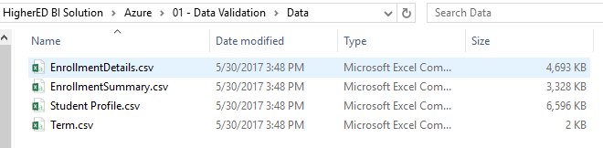
Populate the .csv Files
Open the 01 - Data Validation > Data folder.
Open and review each file.
Populate each file with your schools data or leave as is and go to next step.

Slide 3
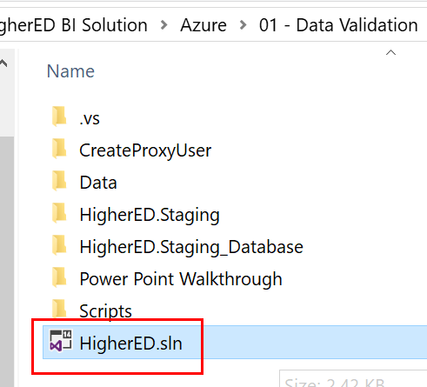
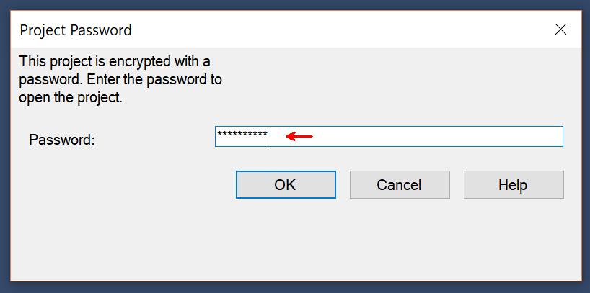
Deploy Staging Database
Open the HigherED Solution located in the 01 - Data Validation folder. The some of the project files may be password protected. The password for the project files is: pass@word1 (1 is the number one)

Slide 4
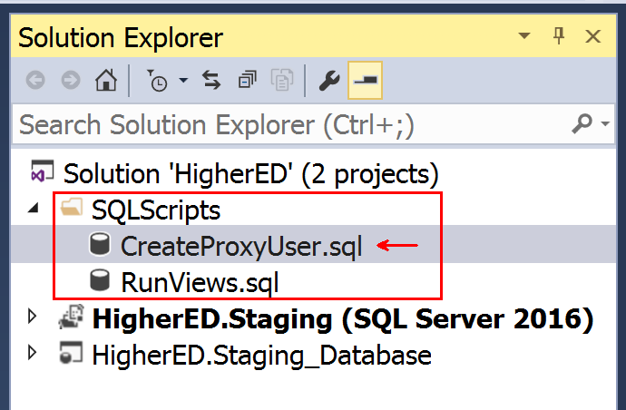
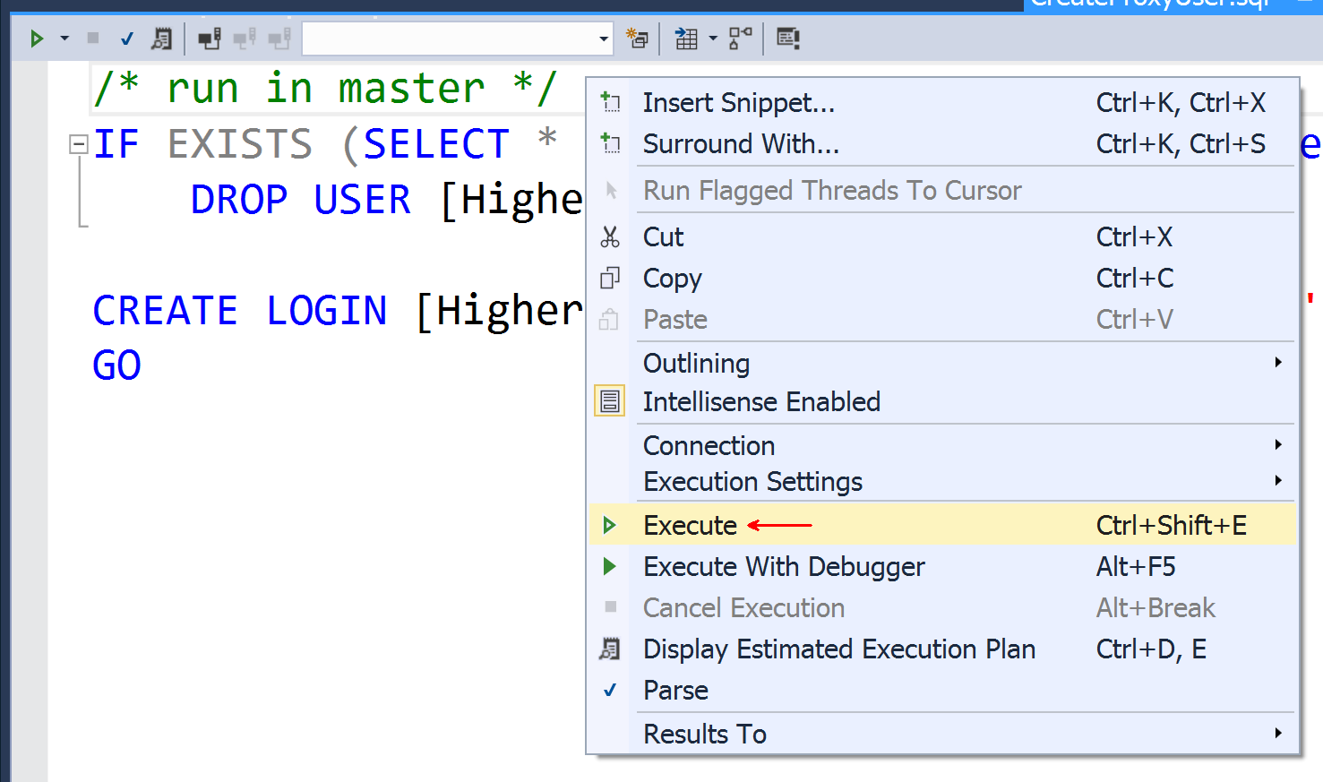
Deploy Staging Database
Expand the SQLScripts folder in the Solution Explorer. Double click on the CreateProxyUser.sql query to open the SQL Editor.
Right click in the SQL Editor and select Execute.

Slide 5
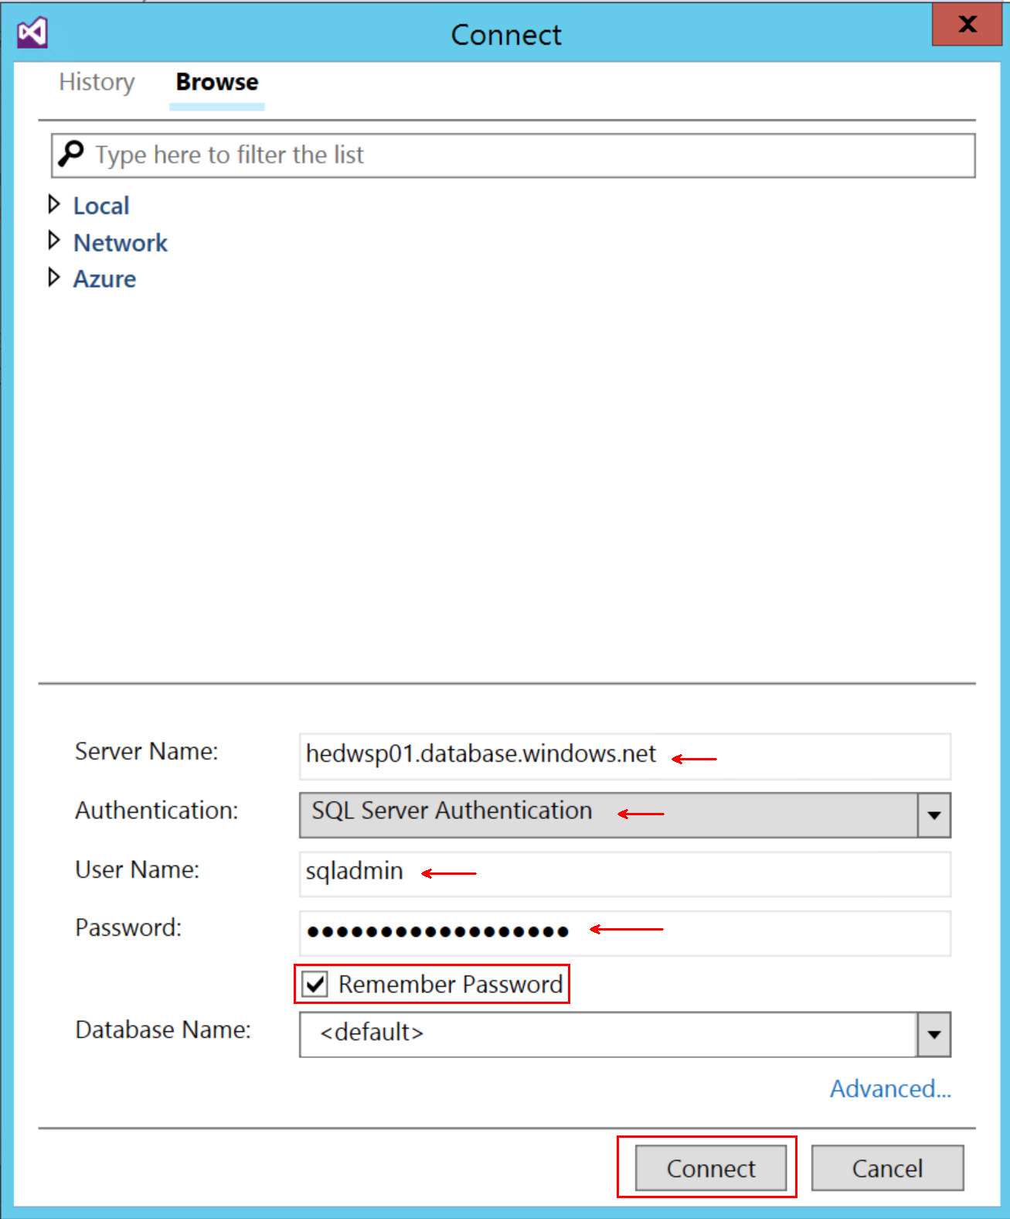
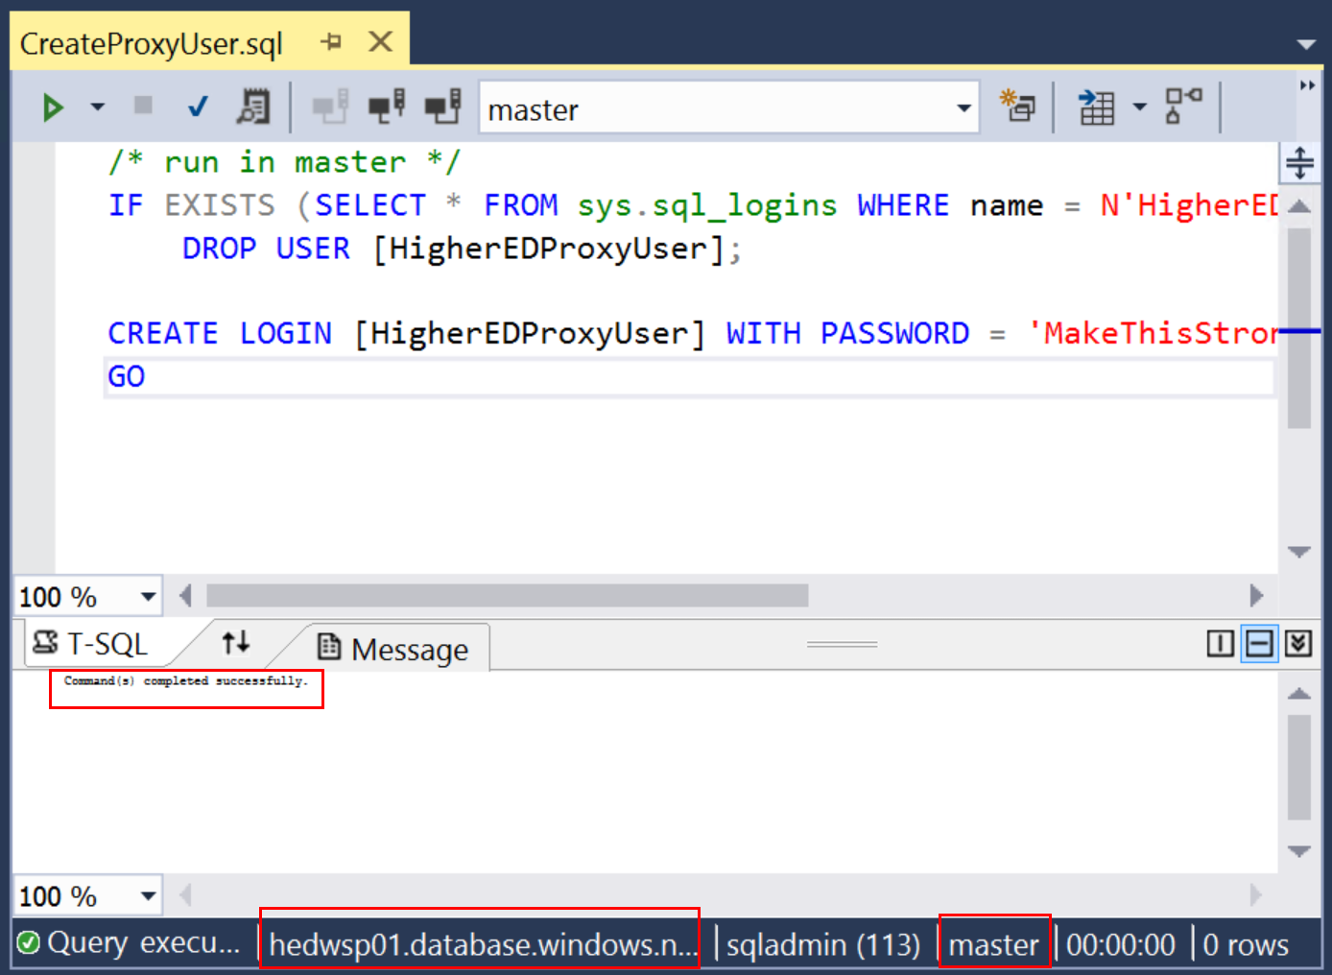
Deploy Staging Database
Enter the name of the Azure SQL Database server, select SQL Server Authentication, enter the user name for the Azure SQL Admin, password for the Azure SQL Admin and check the Remember Password box to save the connection information. Click Connect to run the script which will create a proxy user for use in working with the staging and data warehouse databases.
Review the query execution results to make sure that the HigherEDProxyUser user account was created.

Slide 6
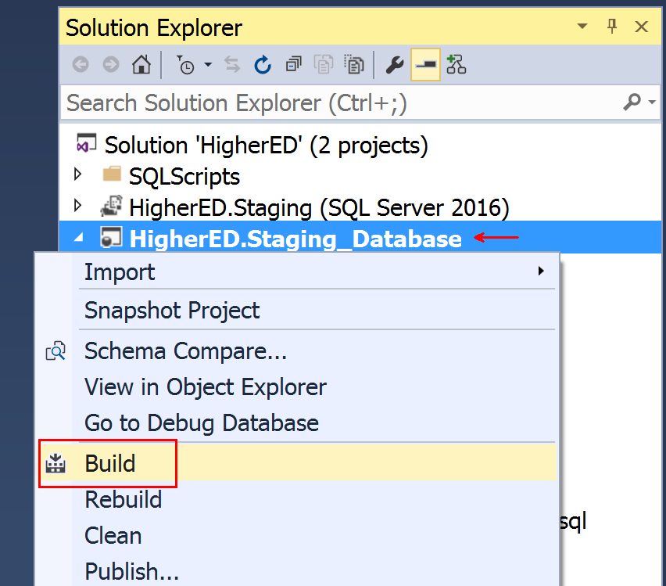
Deploy Staging Database
Right-click the HigherEd.Staging_Database project and select Build from the context menu.

Slide 7
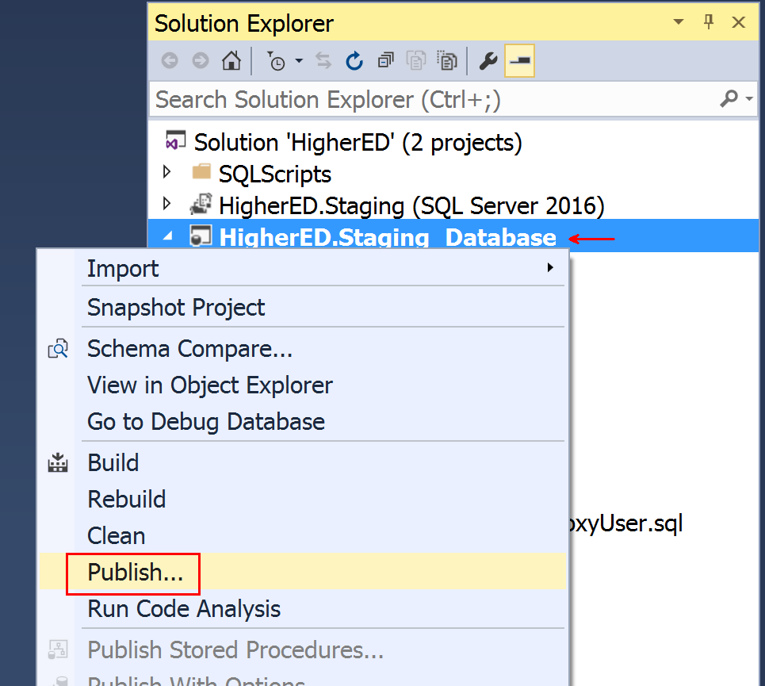
Deploy Staging Database
Right-click the HigherEd.Staging_Database project and select Publish from the context menu.

Slide 8
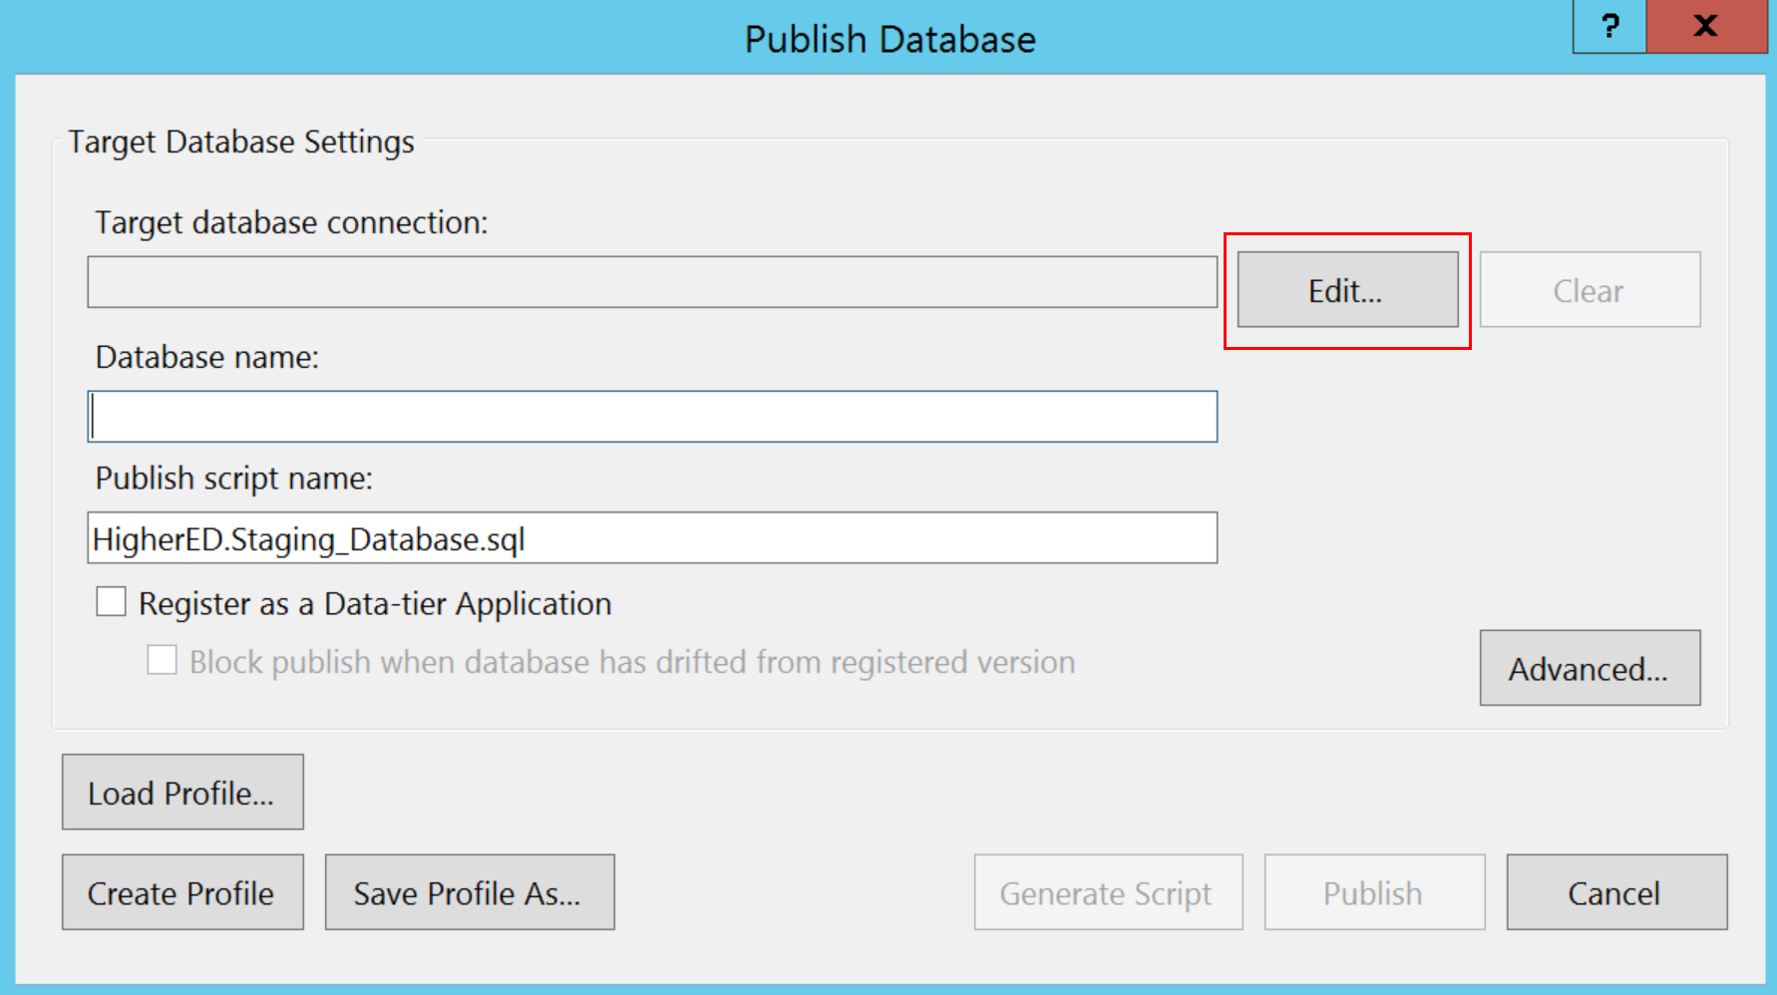
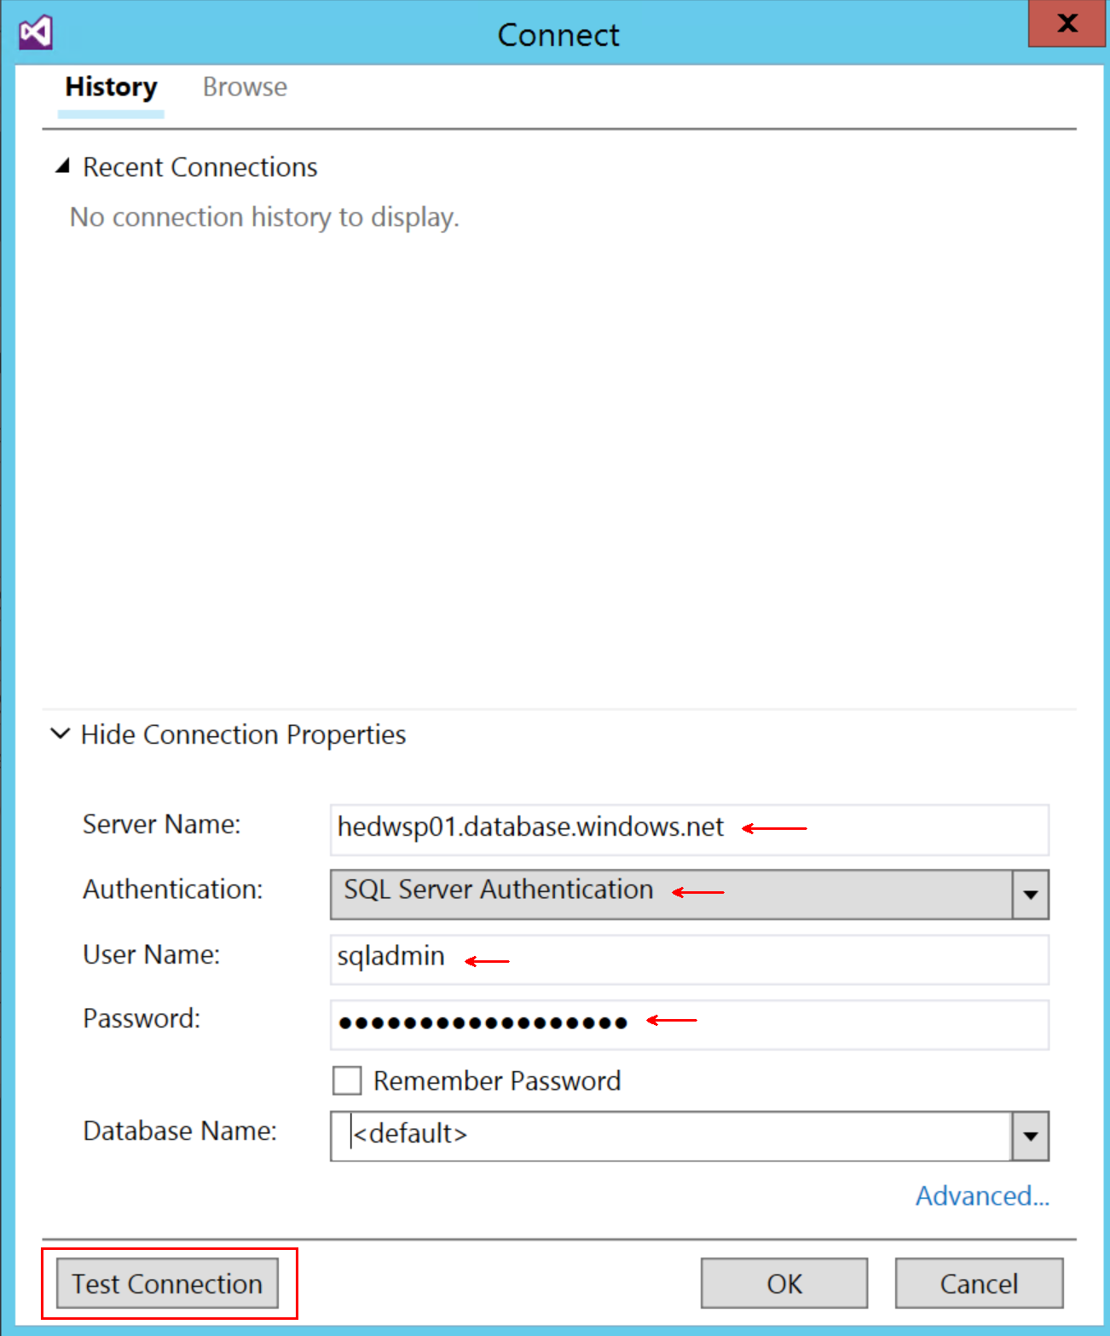
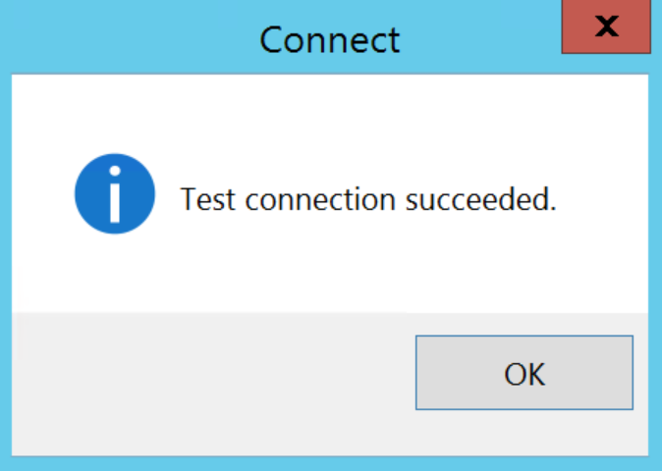
Deploy Staging Database
Click the button labeled Edit.
Click Show Connection Properties towards the bottom of the window
Enter your Azure SQL Server Name in the textbox labeled Server Name.
Choose SQL Server Authentication
Enter the Admin user name and password
Click the button labeled Test Connection.
If you see Test connection succeeded, then click OK and click OK on the to complete the connection.

Slide 9
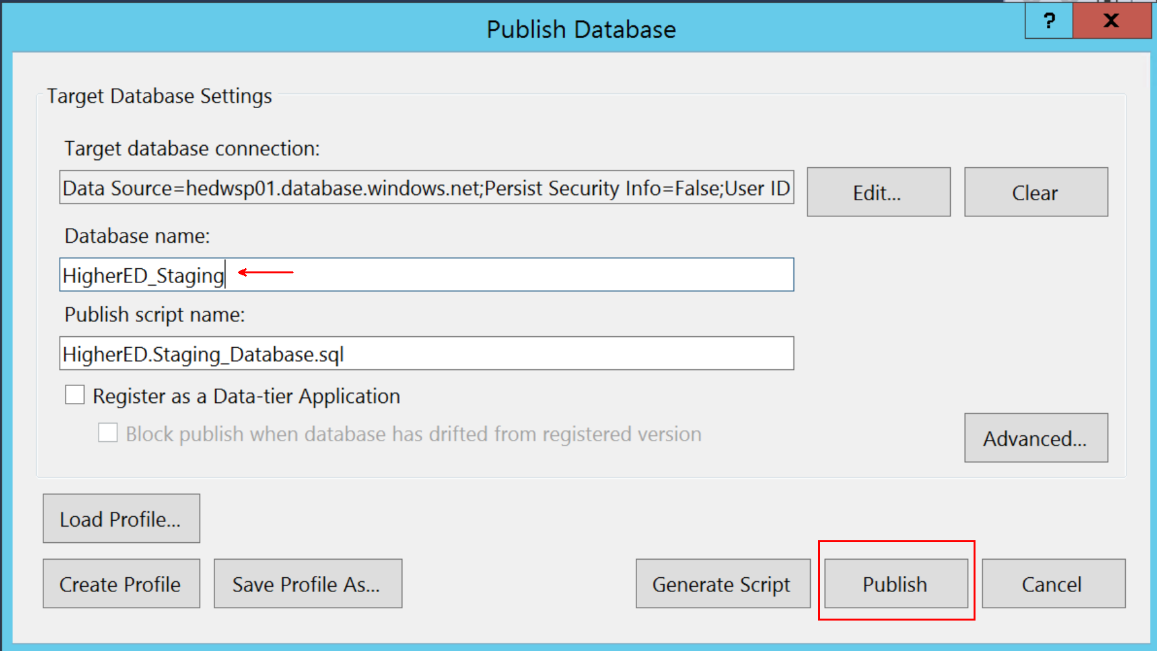
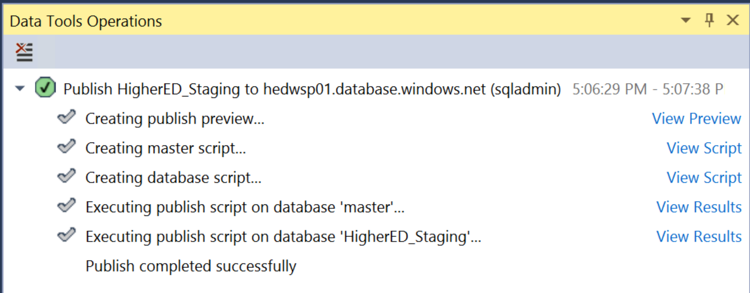
Deploy Staging Database
Enter HigherED_Staging for the Database name and click Publish. The Data Tools Operations window will show the results of the deployment.

Slide 10
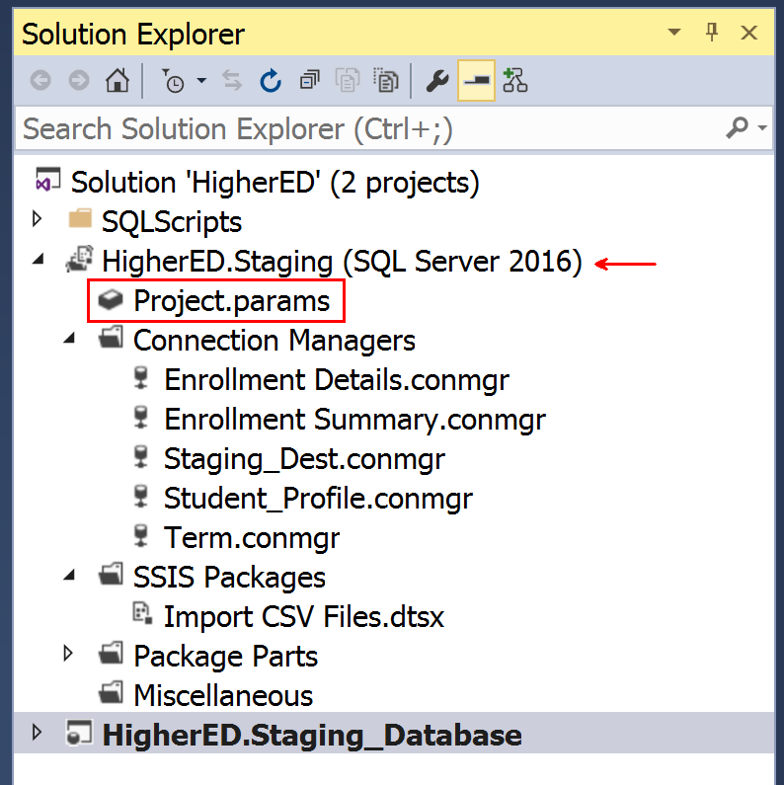
Deploy Staging SSIS Packages
Expand the HigherED.Staging Solution
Double-click Projects.params in the HigherED.Staging Project.

Slide 11
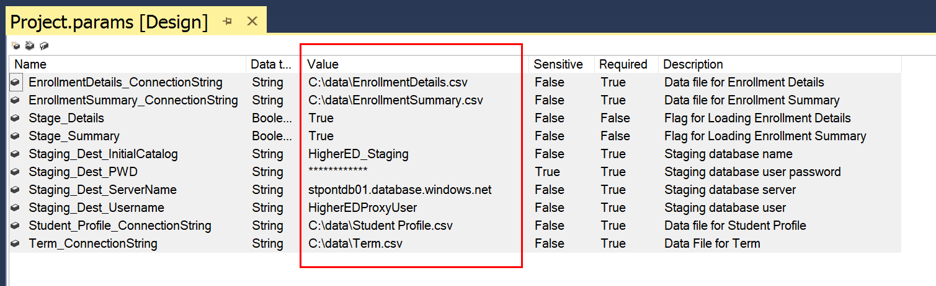
Deploy Staging SSIS Packages
Update the file locations for: EnrollmentDetails_ConnectionString, EnrollmentSummary _ConnectionString, Student_Profile _ConnectionString and Term _ConnectionString
Change the Staging_Dest_ServerName to your server name.
The Staging_Dest_Username and Staging_Dest_PWD are pre-populated with the correct values for the proxy account created when provisioning the staging database. The values are HigherEDProxyUser and MakeThisStrong123! in the event that you have to re-enter them.

Slide 12
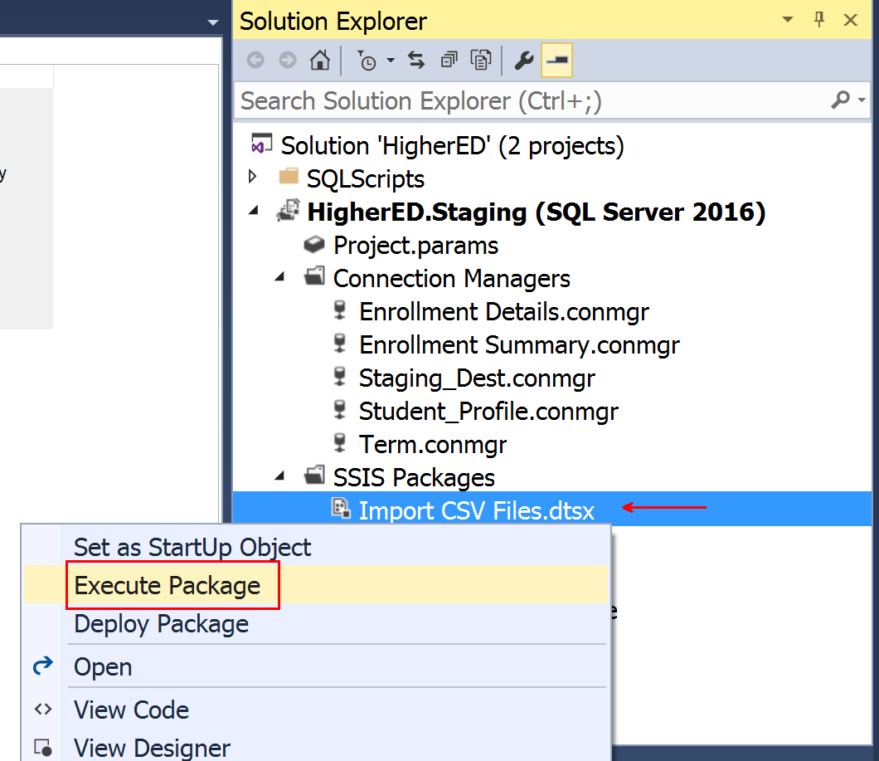
Deploy Staging SSIS Packages
Right-click the Import CSV Files.dtsx SSIS Package and select Execute Package from the context menu.

Slide 13
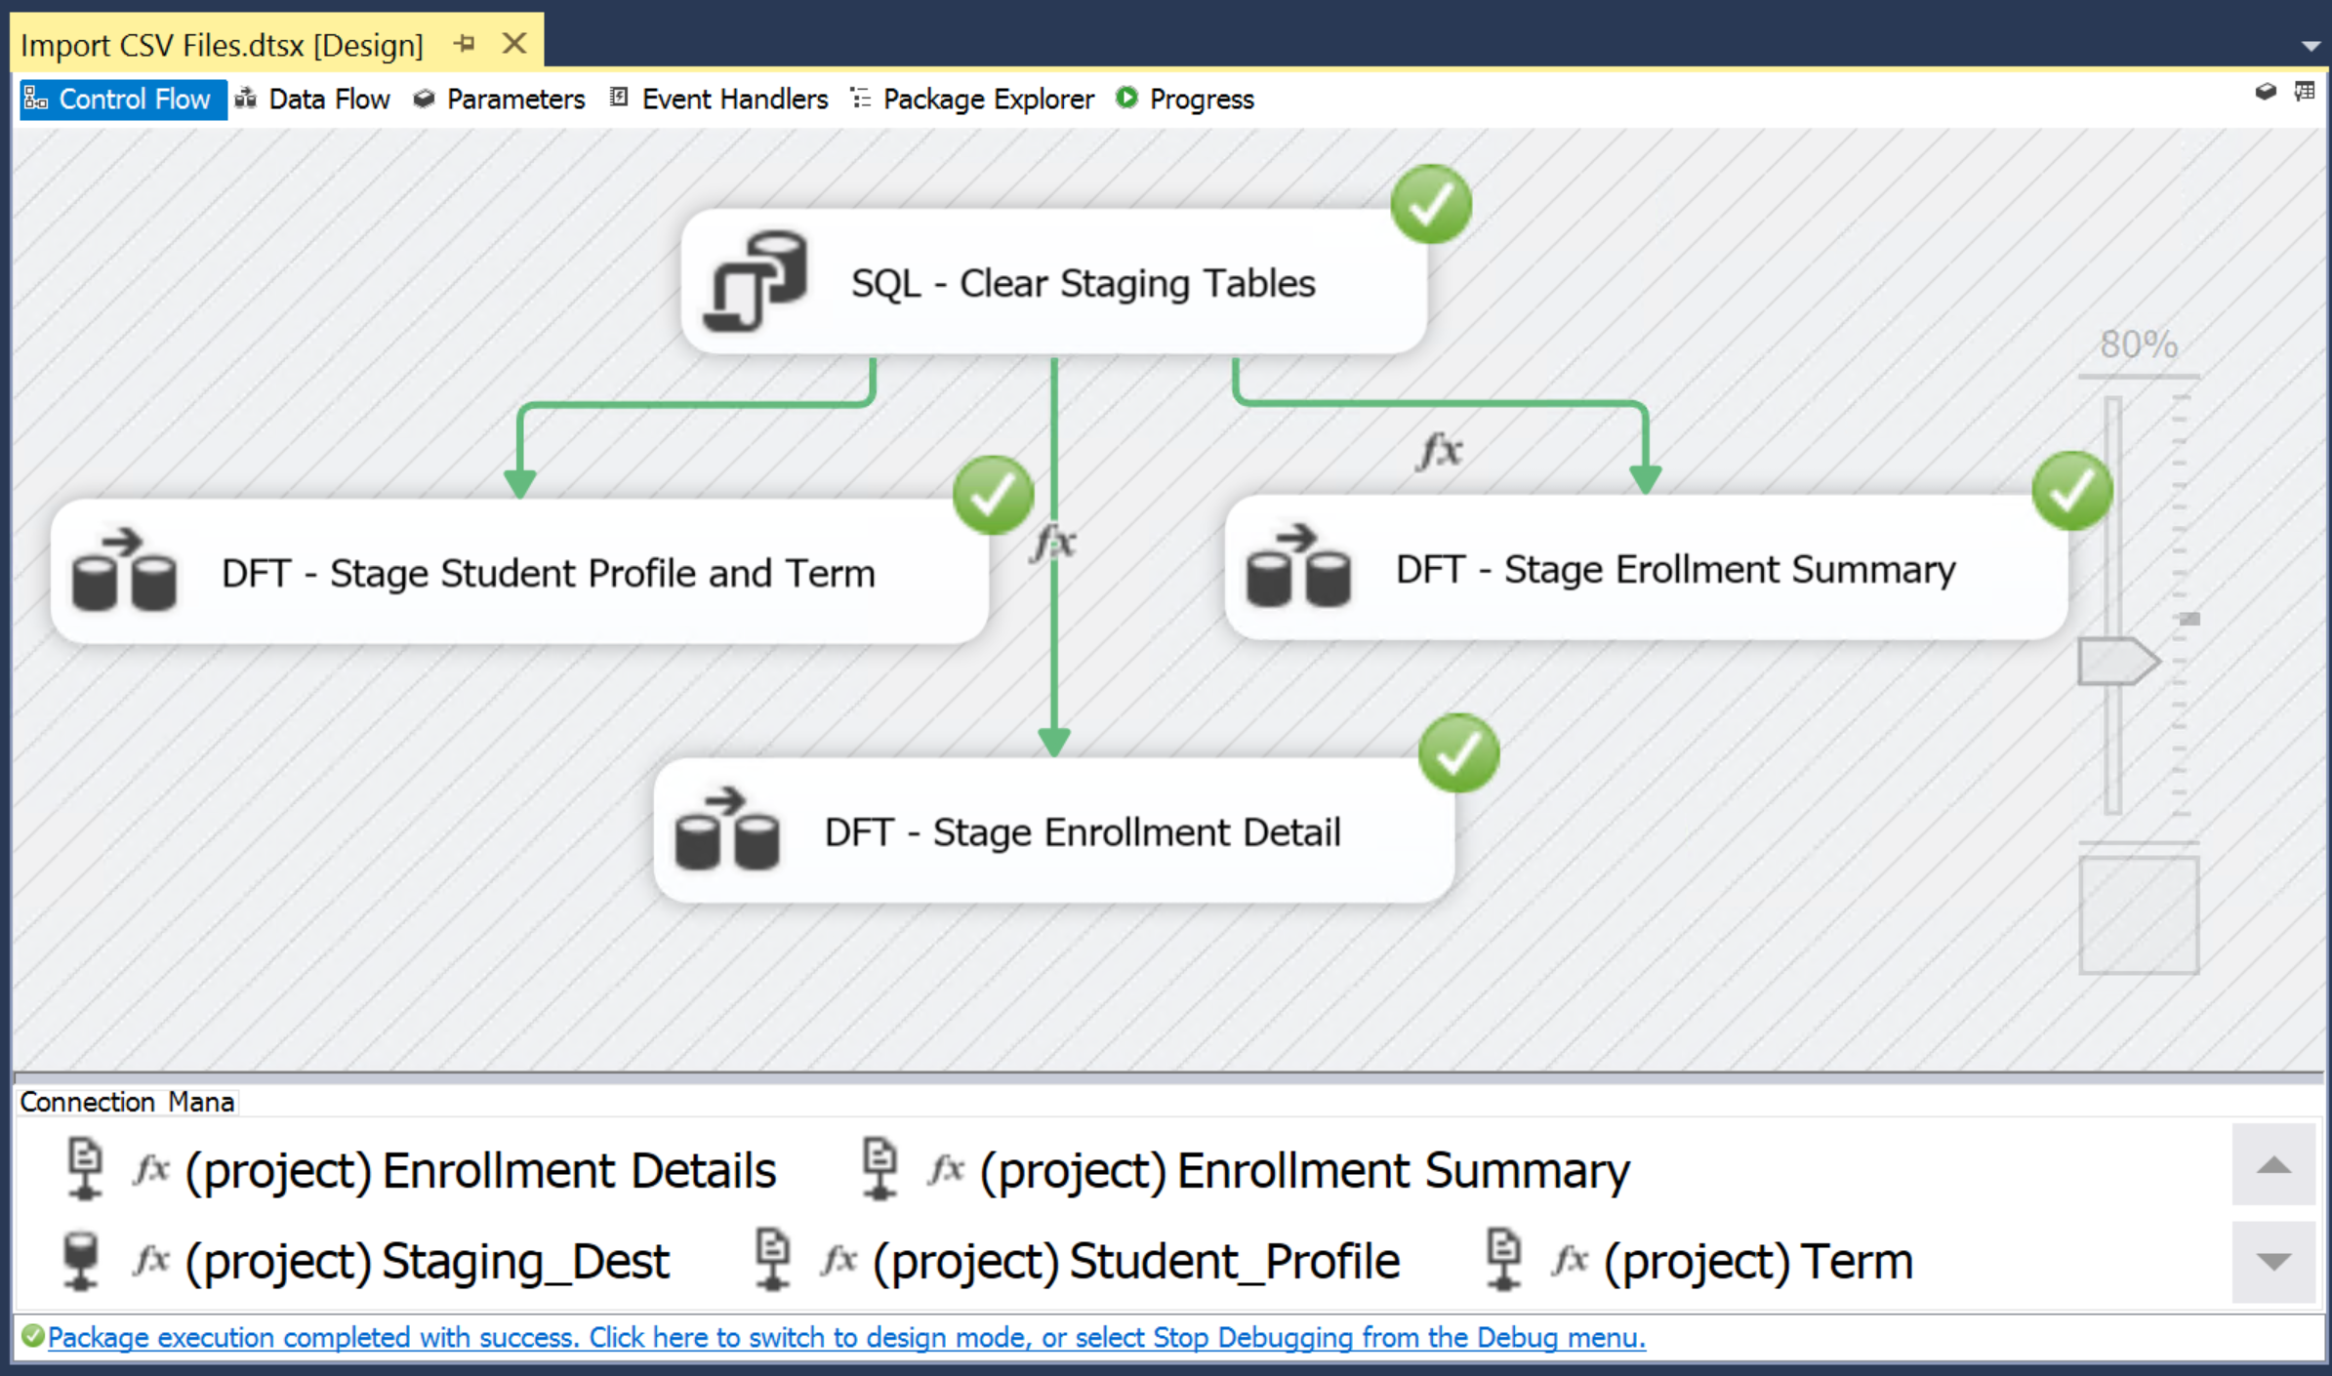
Deploy Staging SSIS Packages
The package should run successfully and load all of the staging tables. If the package does not run successfully, debugging may be required.

Slide 14
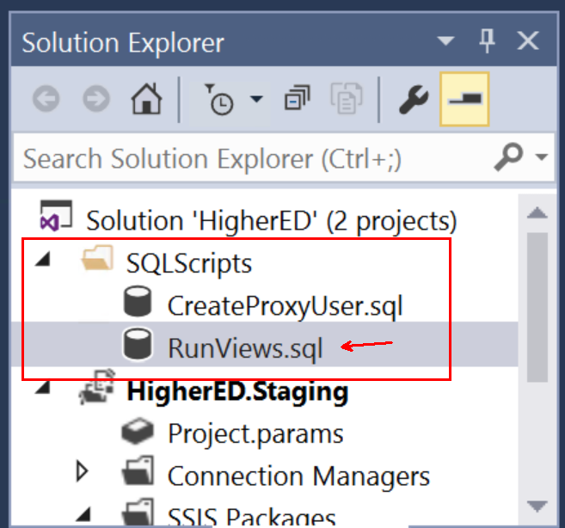
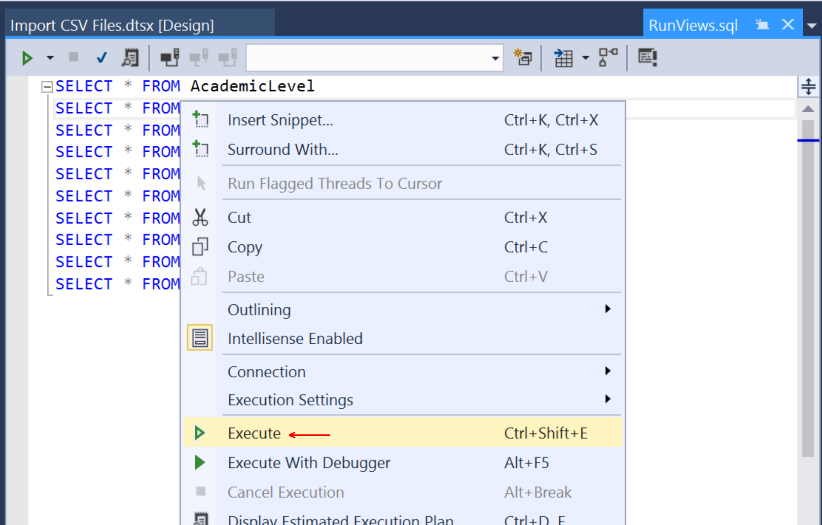
Deploy Staging SSIS Packages
Expand the SQLScripts folder in the Solution Explorer. Double click on the RunViews.sql query to open the SQL Editor.
Right click in the SQL Editor and select Execute.

Slide 15
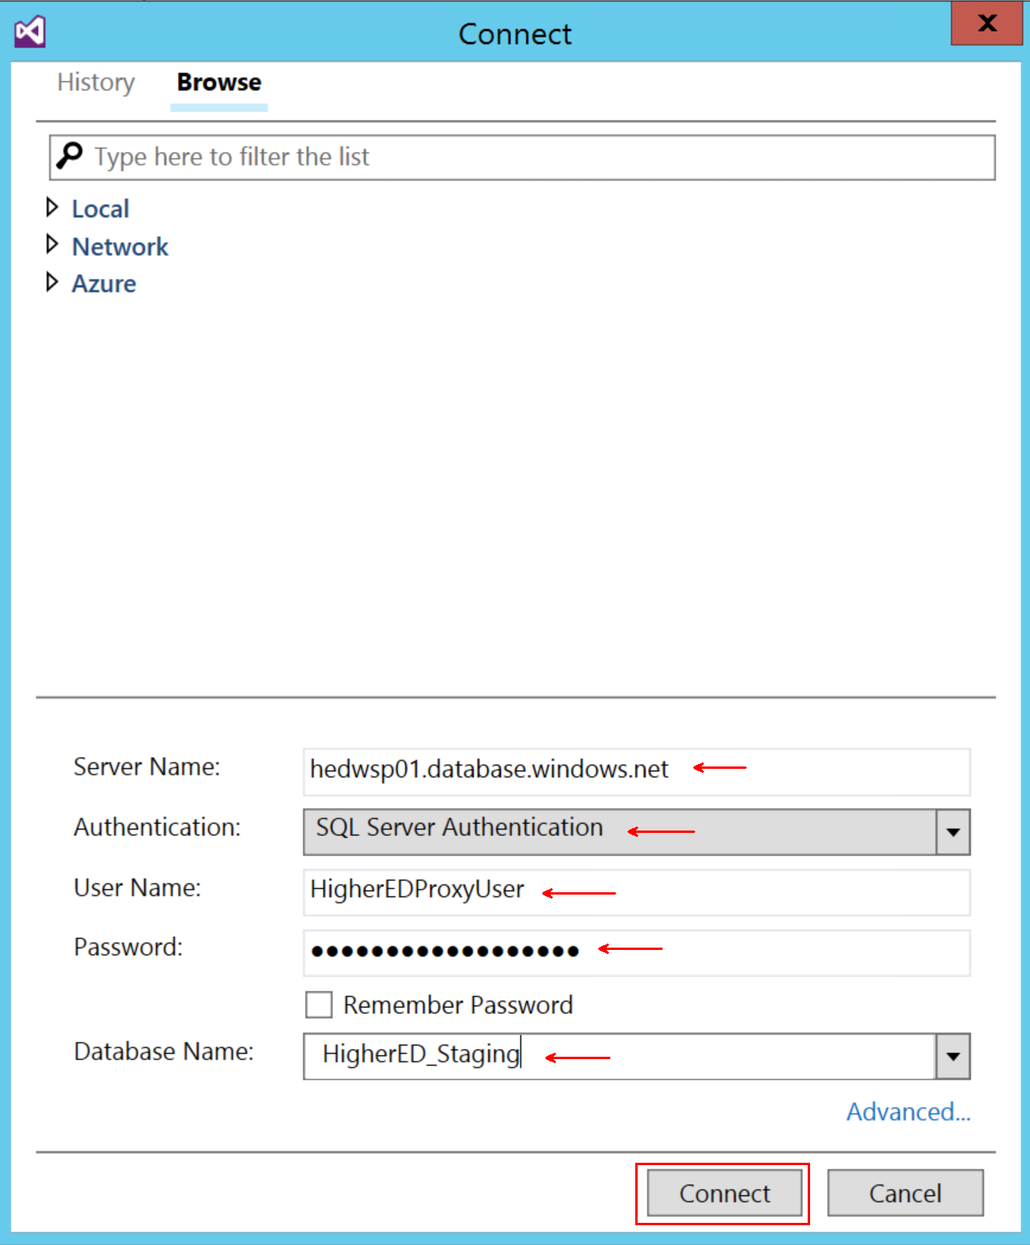
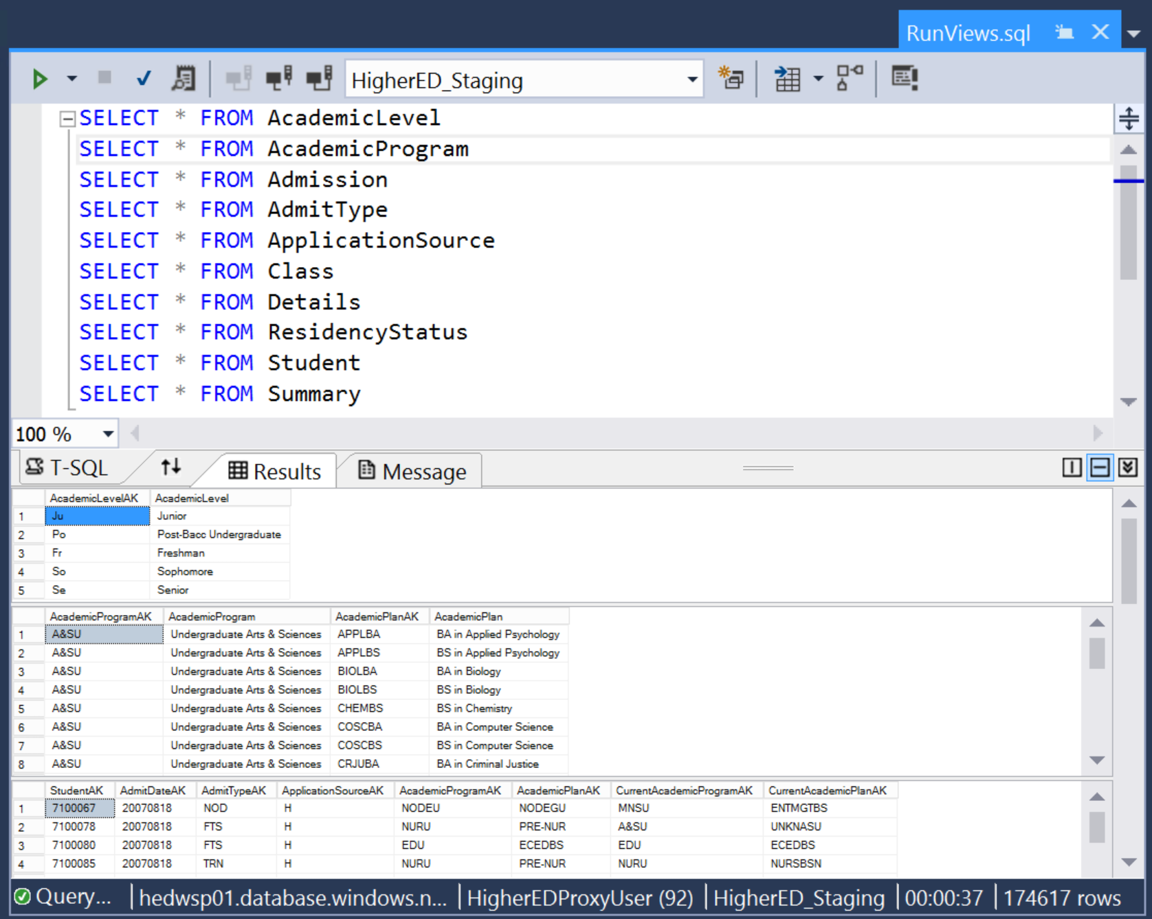
Deploy Staging SSIS Packages
Enter the name of the Azure SQL Database server, select SQL Server Authentication, enter HigherEDProxyUser as the user name, MakeThisStrong123! for the password and HigherED_Staging for the Database Name. Click Connect to run the script which will query the staging database tables.
Execute the script. If any tables are empty are errors appear you should reach out to you Microsoft Contact to help resolve.

